Slide 1
Bags
Chapter 1
Data Structures and Abstractions with Java, 4e
Frank Carrano
© 2015 Pearson Education, Inc., Upper Saddle River, NJ. All rights reserved.

Slide 2
The ADT Bag
Definition
  A finite collection of objects in no particular order
  Can contain duplicate items
Possible behaviors
  Get number of items
  Check for empty
  Add, remove objects
© 2015 Pearson Education, Inc., Upper Saddle River, NJ. All rights reserved.

Slide 3
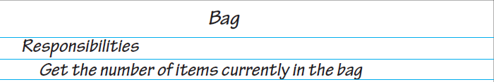
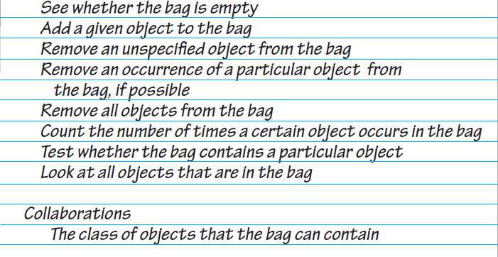
CRC Card
FIGURE 1-1 A CRC card for a class Bag
© 2015 Pearson Education, Inc., Upper Saddle River, NJ. All rights reserved.

Slide 4
Specifying a Bag
Describe its data and specify in detail the methods
Options that we can take when add cannot complete its task:
  Do nothing
  Leave bag unchanged, but signal client
Note which methods change the object or do not
© 2015 Pearson Education, Inc., Upper Saddle River, NJ. All rights reserved.

Slide 5
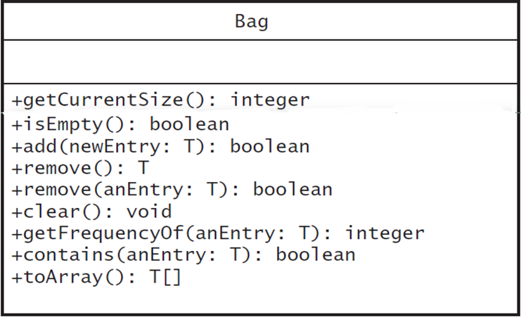
UML Notation
FIGURE 1-2 UML notation for the class Bag
© 2015 Pearson Education, Inc., Upper Saddle River, NJ. All rights reserved.

Slide 6
Design Decision
What to do for unusual conditions?
Assume it won’t happen
Ignore invalid situations
Guess at the client’s intention
Return value that signals a problem
Return a boolean
Throw an exception
© 2015 Pearson Education, Inc., Upper Saddle River, NJ. All rights reserved.

Slide 7
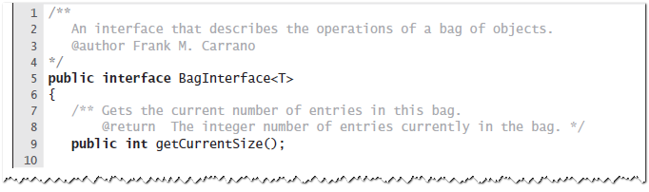
An Interface
LISTING 1-1 A Java interface for a class of bags
© 2015 Pearson Education, Inc., Upper Saddle River, NJ. All rights reserved.

Slide 8
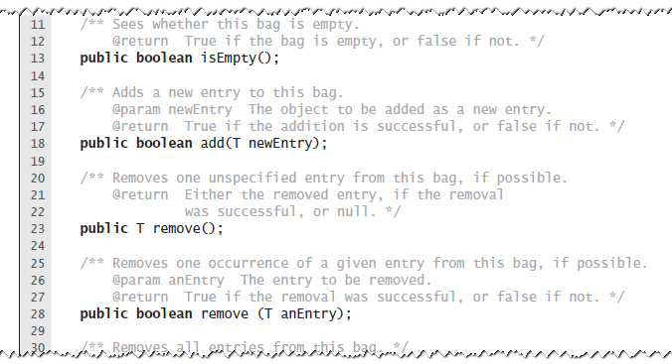
An Interface
LISTING 1-1 A Java interface for a class of bags
© 2015 Pearson Education, Inc., Upper Saddle River, NJ. All rights reserved.

Slide 9
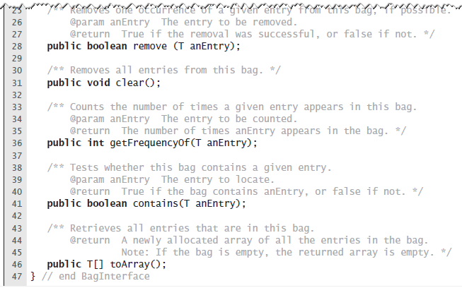
An Interface
LISTING 1-1 A Java interface for a class of bags
© 2015 Pearson Education, Inc., Upper Saddle River, NJ. All rights reserved.

Slide 10
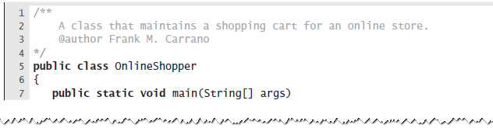
Using the ADT Bag
LISTING 1-2 A program that maintains a bag
for online shopping
© 2015 Pearson Education, Inc., Upper Saddle River, NJ. All rights reserved.

Slide 11
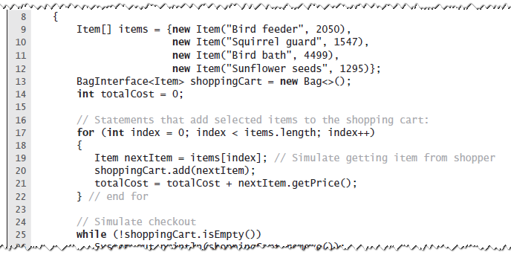
Using the ADT Bag
LISTING 1-2 A program that maintains a bag
for online shopping
© 2015 Pearson Education, Inc., Upper Saddle River, NJ. All rights reserved.

Slide 12
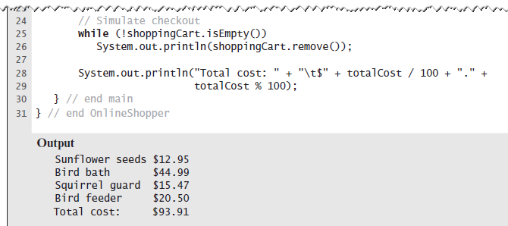
Using the ADT Bag
LISTING 1-2 A program that maintains a bag
for online shopping
© 2015 Pearson Education, Inc., Upper Saddle River, NJ. All rights reserved.

Slide 13
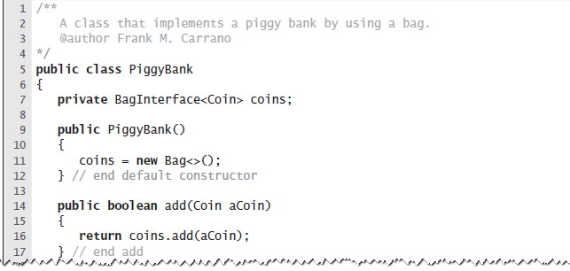
Example: A Piggy Bank
LISTING 1-3 A class of piggy banks
© 2015 Pearson Education, Inc., Upper Saddle River, NJ. All rights reserved.

Slide 14
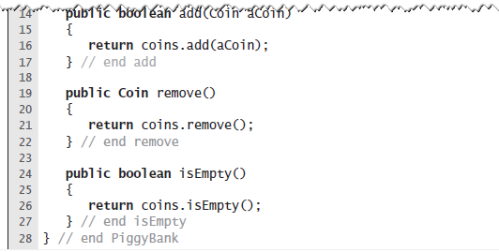
Example: A Piggy Bank
LISTING 1-3 A class of piggy banks
© 2015 Pearson Education, Inc., Upper Saddle River, NJ. All rights reserved.

Slide 15
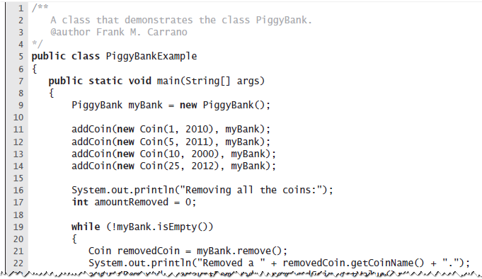
Example: A Piggy Bank
LISTING 1-4 A demonstration of the class PiggyBank
© 2015 Pearson Education, Inc., Upper Saddle River, NJ. All rights reserved.

Slide 16
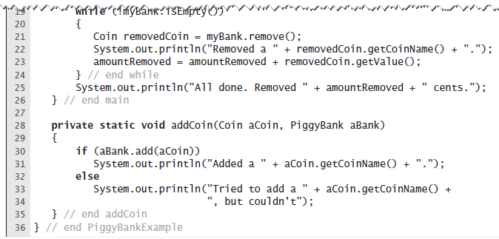
Example: A Piggy Bank
LISTING 1-4 A demonstration of the class PiggyBank
© 2015 Pearson Education, Inc., Upper Saddle River, NJ. All rights reserved.

Slide 17
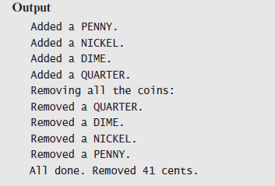
Example: A Piggy Bank
LISTING 1-4 A demonstration of the class PiggyBank
© 2015 Pearson Education, Inc., Upper Saddle River, NJ. All rights reserved.

Slide 18
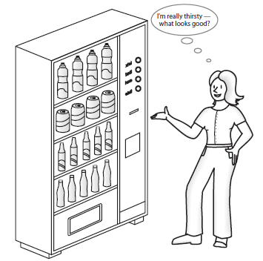
Using ADT
Like Using Vending Machine
FIGURE 1-3 A vending machine
© 2015 Pearson Education, Inc., Upper Saddle River, NJ. All rights reserved.

Slide 19
Observations about
Vending Machines
Can perform only tasks machine’s interface presents.
You must understand these tasks
Cannot access the inside of the machine
You can use the machine even though you do not know what happens inside.
Usable even with new insides.
© 2015 Pearson Education, Inc., Upper Saddle River, NJ. All rights reserved.

Slide 20
Observations about ADT Bag
Can perform only tasks specific to ADT
Must adhere to the specifications of the operations of ADT
Cannot access data inside ADT without ADT operations
Use the ADT, even if don’t know how data is stored
Usable even with new implementation.
© 2015 Pearson Education, Inc., Upper Saddle River, NJ. All rights reserved.

Slide 21
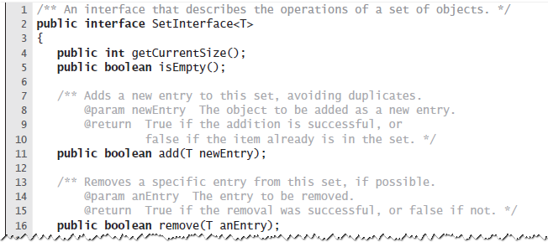
Java Class Library: The Interface Set
Listing 1-5 A Java interface for a class of sets
© 2015 Pearson Education, Inc., Upper Saddle River, NJ. All rights reserved.

Slide 22
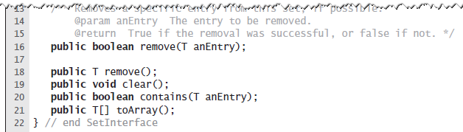
Java Class Library: The Interface Set
Listing 1-5 A Java interface for a class of sets
© 2015 Pearson Education, Inc., Upper Saddle River, NJ. All rights reserved.

Slide 23
End
Chapter 1
© 2015 Pearson Education, Inc., Upper Saddle River, NJ. All rights reserved.

